Slide 1
What Caused the Most Flight Delays in 2015?
The following is a Tableau dashboard that analyzes what causes delays and cancellations of select airlines in 2015.
It can be seen most of the delays are caused in June 2015 .
The three most seen reason in flight delays are Bad Weather, delay caused from airline and air system .
But as expected most of the delays are due to weather ,
I have chosen bar charts to make feel the difference of factors causing delay and stacked bar charts for clear visualization of the majority delay caused by which reason and which reason caused most delay in month and weather seems most disturbing in june month

Slide 2
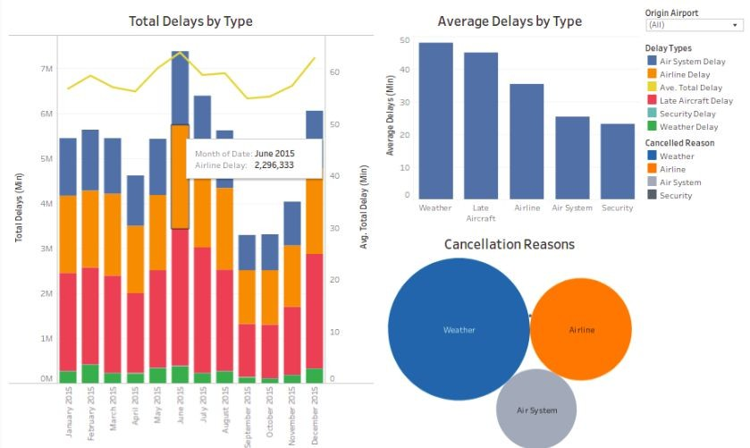

Slide 3
Which Airlines Had the Most Delays in 2015?
The following is a Tableau dashboard that analyzes delays and cancellations of select airlines in 2015.
It clearly visualize which airlines had most delay in June

Slide 4
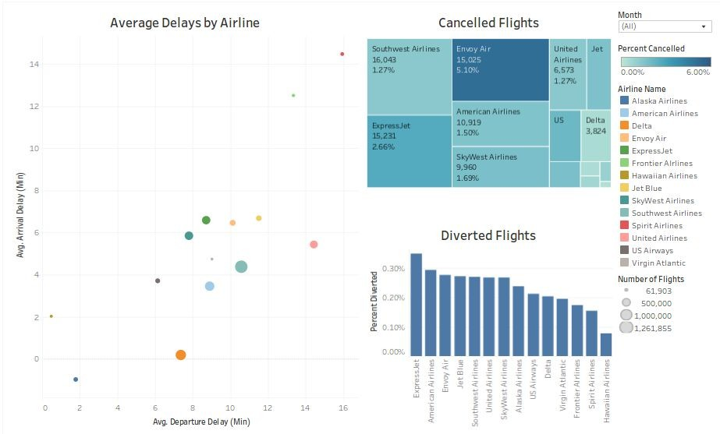

Slide 5
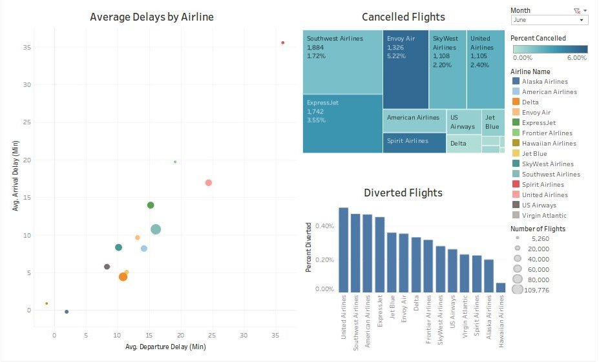

Slide 6
We can see most of the cancelled flights are from Southwest airlines.
Most diverted flights are of United Airlines.
I have used Tree map for displaying the hierarchical data so that for easy understand the visualization as Each branch of the tree is given a rectangle, which is then tiled with smaller rectangles representing sub-branches,which will give easy visual communication to client or viewers.

